Slide 1

Archie: a question answering model
CS6120: Natural Language Processing

Slide 2
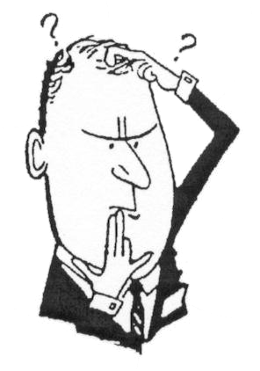

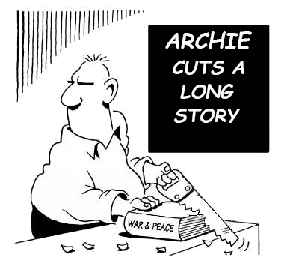
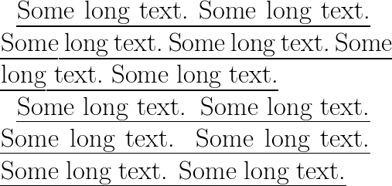
What are we working on?
Archie: Our question answering model

Slide 3

Our approach
SQuAD Dataset
Pre-Processing
VECTORS
Contextual Binding
(GloVe)
Train the Model
(RNN)
Evaluation
Configuring the Parameters

Slide 4
Data pre-processing
Context
Question
Answer
Answer Context
Training Data
Test Data
GLoVe: Global Vectors for Word Representation

Slide 5
How we did it! TRAINING OUR MODEL

Slide 6
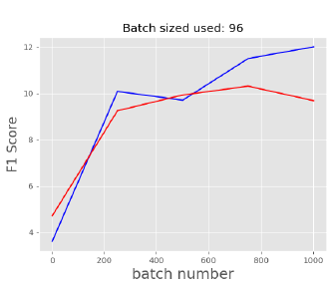
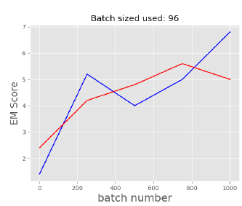
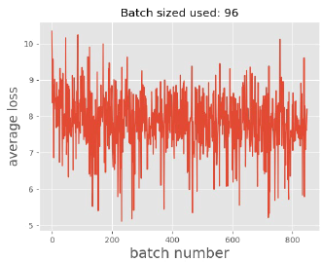
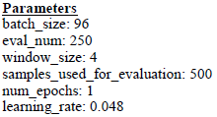
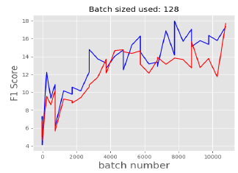
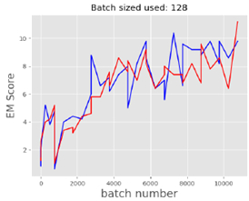
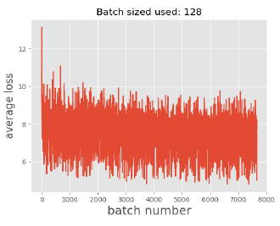
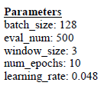
Evaluations and results!

Slide 7
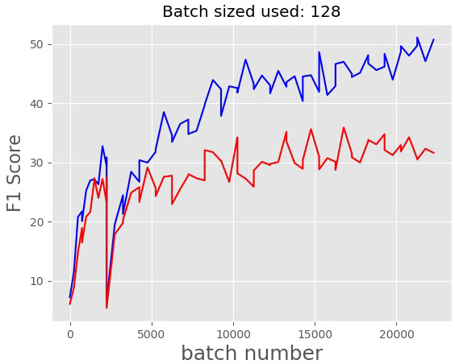
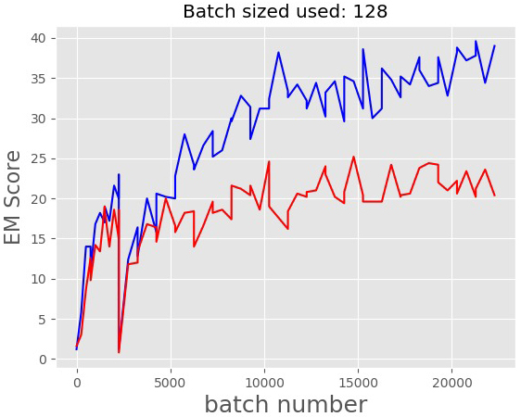
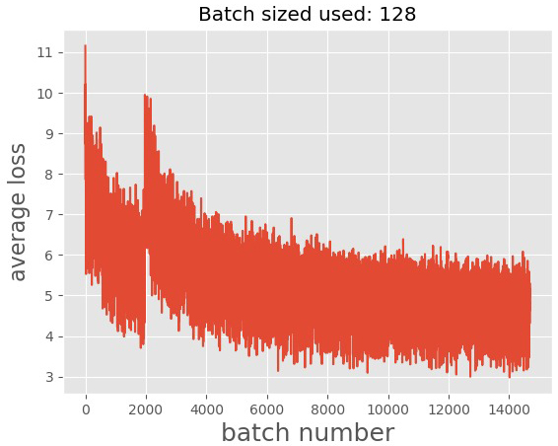
THE PROGRESS WE MADE!
F1 SCORE
EM SCORE
LOSS

Slide 8
FUTURE WORK!
Convert the models output into a human-readable form.
Implement something?

Slide 9

Questions?
THANK YOU!

